Slide 1
CZ2001: Algorithms
Lab Project-1
Jin Yang, Hu Soon, Aneez, Parth, Junyan

Slide 2
Presentation Agenda
Algorithms & Time Complexities
Empirical Analysis & Conclusion
Live Demonstration
Q & A

Slide 3

Algorithms & Time Complexities
Notes:
Moving on to the algorithms

Slide 4
Brute Force Algorithm (Naive)
A C A G T C A A G T T G A C T A A C T A T A C G T G A
Step 1
A G T C A A G A
Step 2
A C A G T C A A G T T G A C T A A C T A T A C G T G A
A G T C A A G A
Step 3
A C A G T C A A G T T G A C T A A C T A T A C G T G A
A G T C A A G A
A C A G T C A A G T T G A C T A A C T A T A C G T G A
Step 4
A G T C A A G A
Notes:
As we all know how brute force works very well, I will be going straight into the time complexity analysis.

Slide 5
Brute Force Algorithm (Naive)
Best case:
To achieve the best time complexity, we want to minimize the number of comparisons per iteration.

Slide 6
Best case:
Start matching from: Index[0] of query sequence: 1 comparison Index[1] of query sequence: 1 comparison ….. (n-m+1) rows Index[n-m-1] of query sequence: 1 of comparison Index[n-m] of query sequence: 1 comparison
Therefore, sum of comparisons = (n-m+1) < n, ∈ O(n)
T C G G T C G T T G C T C T T C G
Step 1
A G T C A A G A
Step 2
T C G G T C G T T G C T C T T C G
A G T C A A G A
Step 3
T C G G T C G T T G C T C T T C G
A G T C A A G A
In order to achieve this, the first character in the query sequence must not match any character in the genome sequence. As a result, we will have only one comparison before shifting the query sequence to the next position.
T C G G T C G T T G C T C T T C G
Step 4
A G T C A A G A

Slide 7
Brute Force Algorithm (Naive)
Worst case:
To achieve the worst time complexity, we want to maximize the number of comparisons per iteration.

Slide 8
Worst Case:
Start matching from: Index[0] of query sequence: m number of comparisons Index[1] of query sequence: m number of comparisons ….. (n-m+1) rows Index[n-m-1] of query sequence: m number of comparisons Index[n-m] of query sequence: m number of comparisons Therefore, sum of comparisons: (n-m+1) * m = nm – m^2 + m < nm+m ∈ O(nm)
To achieve this, all characters in the query sequence must match up to the last character in the genome sequence. As a result, we will then have a maximum of m comparisons before shifting the query sequence to the next position for a total of (n-m+1) positions.
A A A A A A A A A A A A A A A
Step 1
A A A A A A
Step 2
A A A A A A A A A A A A A A A
A A A A A A
Step 3
A A A A A A A A A A A A A A A
A A A A A A
A A A A A A A A A A A A A A A
Step 4
A A A A A A
Notes:
To achieve this, all characters in the query sequence must match up to the last character in the genome sequence. As a result, we will then have a maximum of m comparisons before shifting the query sequence to the next position for a total of (n-m+1) positions.

Slide 9
Original Algorithm
Substring: T A T A C G T G (M)
Dataset: A C T G A C T G A C T A A C T G A C T A T A C G T G A (N)
Start point of the substring
Instead of the substring (M) move 1 by 1 across the dataset (N)
We make the substring hop across the dataset (N)
With this idea, we could decrease the time taken moving across the dataset (N)
BUT… How do we let the program know where to jump and where to stop?

Slide 10
Original Algorithm
Substring: T A T A C G T G (M)
Dataset: A C T G A C T G A C T A A C T G A C T A T A C G T G A (N)
Combination | Index
A, G | 3 , 1
T, T | 2
T, C | 0
T A T A C G T G
T A T A C G T G
Condition to position substring: 2 Gs with 3 characters apart
Condition to position substring: G and A with 3 characters apart
Condition to position substring: A and G with 3 characters apart
T A T A C G T G
Condition to position substring: G and A with 3 characters apart
Condition to position substring: A and G with 3 characters apart
Condition fail, means substring cannot lies within this 2 point
Condition fail, means substring cannot lies within this 2 point
Condition pass, means substring might lie within this 2 point
Condition fail, means substring cannot lies within this 2 point
Condition pass, means substring might lie within this 2 point
Jump points
We set up 2 jumping points as pivot points to identify where we should position the substring after each jump
Using the 2 jumping points, we can look into the index table that we will set up beforehand to return the position that the program should decrease if two jump points hits

Slide 11
Original Algorithm
Combination | Index
A, G | 3 , 1
T, T | 2
T, C | 0
Substring: T A T A C G T G (M)
Dataset: A C T G A C T G A C T A A C T G A C T A T A C G T G A (N)
Jump points
Maximize jumps so as to decreasing the linear traversing time across the dataset. How?
If the jump points are too small, we are not efficiently maximizing the jump
If the jump points are too big, we might miss the answers that exist in between the jump points
Gap will be determined by the length of the string
Gap must be maximized
The length of the string, sliding at any point, the string has to touch a minimum of 2 jump points
If gap length is even, the gap (space between 2 jump points ) will be computed by [(length-1)/2] - 1
If gap length is odd, the gap (space between 2 jump points ) will be computed by floor of [(length-1)/2 ]

Slide 12
Original Algorithm
Pros | Cons
Inherit the characteristics of pattern searching, speeds up the linear traversing across dataset | For sub-string length that are 3 and lesser, time complexity is the same as brute force as we couldn’t produce jump points without jeopardizing the accuracy
Algorithm, in theory is faster as the length of substring increases, because it determines the gap size, which is derived from the length of substring

Slide 13
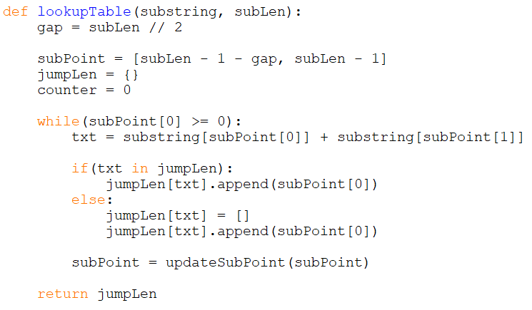
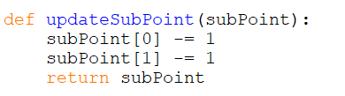
Original Algorithm (Preprocessing)
Will loop for m/2 times
C1
C2
C3
C4
C5
Primitive operations: (m/2)(C)
C6

Slide 14
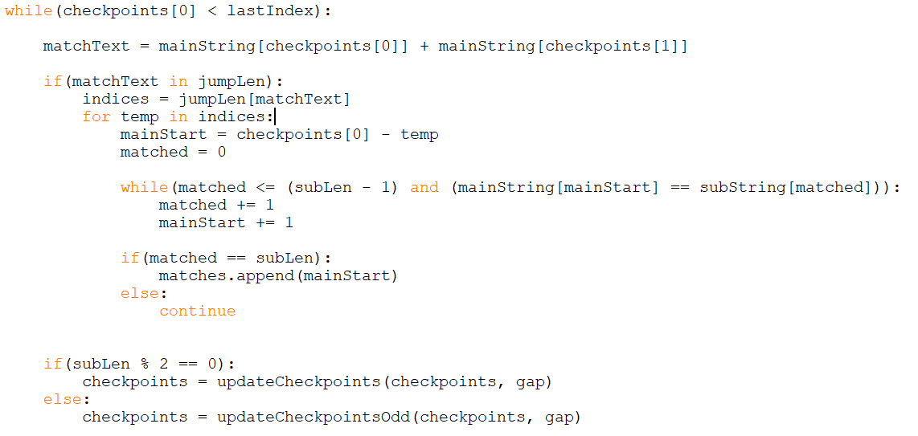
Original Algorithm
Loop for (n/(m/2)) times
C1
C2
Loops for (m/2) times
C3
C4
C5
C6
Loop for m times
C7
C8
C9

Slide 15
Original Algorithm
Total primitive operations: preprocess + actual comparisons
Best case:
(m/2) + (n/(m/2)) -> O(n/m)
Worst case:
(m/2) + (n/(m/2))*(m/2)*(m) = (m/2) + (nm) -> O(nm)

Slide 16
Boyer-Moore Horspool Sunday
The BMHS algorithm works by comparing characters of the substring to the main string from right to left.
As soon as a mismatch is found in the main string, it uses a lookup table to determine the shortest value by which the substring should be shifted, such that the mismatched character is now a match in the substring.
This shift value is recorded. This is the horspool shift.

Slide 17
Boyer-Moore Horspool Sunday
At the same time, it also compares one character ahead of the substring repeats the above procedure.
This shift value is called the sunday shift.
The two shift values are compared. The substring is then shifted by the larger of the two values.
This process continues until the end of the main string is reached.

Slide 18
BMHS Visualization
A | T | G | A | T | C | G | C | A | T | T | T | G | G | A | C | C | T | T | C | C | A
A | C | C | T | T
Shift by 3
A | T | G | A | T | C | G | C | A | T | T | T | G | G | A | C | C | T | T | C | C | A
A | C | C | T | T
5 > 2, so shift by 5

Slide 19
BMHS Visualization
A | T | G | A | T | C | G | C | A | T | T | T | G | G | A | C | C | T | T | C | C | A
A | C | C | T | T
6 > 5, so shift by 5
A | T | G | A | T | C | G | C | A | T | T | T | G | G | A | C | C | T | T | C | C | A
Match Found, shift by 1
A | C | C | T | T

Slide 20
Time Complexity of BMHS: Pre-Processing
Number of characters to pre-process = Length of Substring
= m
Number of iterations in pre-processing = m
If i = n-1, condition is only satisfied in the m^{th} iteration.
Number of comparisons on each of the first (m-1) iteration= 1+1 = 2
Number of comparisons on n^{th} iteration= 1+1 = 2
Thus, total number of comparisons = 2m
Time Complexity is of the order => O(m)

Slide 21
Time Complexity of BMHS: Search Generation
For the Worst Case:
The substring shifts by 1 character at a time until the (n-m+1)^{th} iteration. So, the number of iterations over main string = n-m+1
For the substring, (n-1) characters have to match, and the m^{th} character should be a mismatch. Thus, the number of comparisons with the substring = m
But the Sunday Algorithm would increase it by 1 extra comparison. Hence, the total number of comparisons per iteration of main string = m+1
Total Time = [(Iterations over main string) * (Iterations over substring)] + c
= [(n-m+1)*(m+1)] + c
On solving, the time complexity comes out to be O(nm)

Slide 22
Time Complexity of BMHS: Search Generation
For the Best Case:
The number of main string iterations should be minimised, and for that the shift per iteration should be maximised, which will be equal to n+1 characters.
So, the iterations over main string = (n-m)/(m+1)
To minimise the iterations for the substring, the first character itself shouldn’t match.
Thus, the number of comparisons with the substring = 1
But the Sunday Algorithm would increase it by 1 extra comparison. Hence, the total number of comparisons per iteration of main string = 1+1 = 2
Total Time = [(Iterations over main string) * (Iterations over substring)] + c
= [(n-m)/(m+1)]*2 + c
On solving, the time complexity comes out to be O(n/m)

Slide 23
Empirical Analysis & Conclusion
Notes:
Moving on to the algorithms

Slide 24
 |  | Run Time(s) when length of Query Sequence is:
Algorithm used | Genome Sequence (Characters) | 4 (CATG) | 8(GTATCACT) | 12(AACGTAAAAGTT) | 16(CCACCCTCTATCTTAT) | 32(TGAAACGCTAACAAATGATCGTAAATAACACA)
1. Brute Force | ASM694v2(txt) 4,951,383 | 2.49 | 1.48 | 2.00 | 1.83 | 1.90
 | R64(txt) 12,157,105 | 4.76 | 4.73 | 5.30 | 4.65 | 4.62
 | GRCh38.p13(txt) 3,099,706,404 | 290 | 139 | 129 | 114 | 124
2. Sunday Boyer Moore | ASM694v2(txt) 4,951,383 | 3.04 | 1.93 | 1.20 | 0.78 | 0.97
 | R64(txt) 12,157,105 | 4.60 | 2.93 | 2.23 | 1.59 | 1.46
 | GRCh38.p13(txt) 3,099,706,404 | 327 | 98 | 85 | 58 | 59
3. Original | ASM694v2(txt) 4,951,383 | 1.97 | 1.19 | 0.97 | 0.87 | 0.57
 | R64(txt) 12,157,105 | 4.44 | 2.39 | 1.86 | 1.36 | 0.81
 | GRCh38.p13(txt) 3,099,706,404 | 185 | 74 | 60 | 52 | 29
Notes:
We have collated the results of our runtime and represented the data in a table.

Slide 25
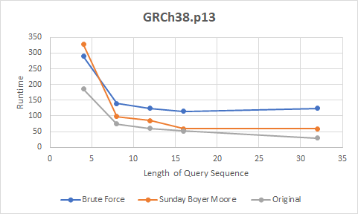
Notes:
As we can see from the graph, the runtime of the Brute Force algorithm does not significantly vary at different query lengths. The performance of this algorithm saturates when the query length crosses 8 characters. As for the Boyer Moore Horspool Sunday (BMHS) algorithm, we see an overall decrease in the runtime as the query length increases. Finally, in the original algorithm, we observe a stable and constant decrease in the runtime even as the length of the query sequence increases.

Slide 26
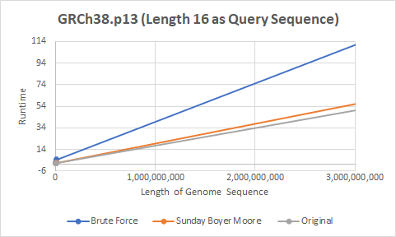
Notes:
Original algorithm and Sunday Algo would perform better on longer queries, where the original algorithm constantly outperforms Sunday. Original algorithm shows the best performance in larger genome sequences, followed by Sunday and Brute-Force respectively.

Slide 27
Live Demonstration
Notes:
Moving on to the algorithms

Slide 28
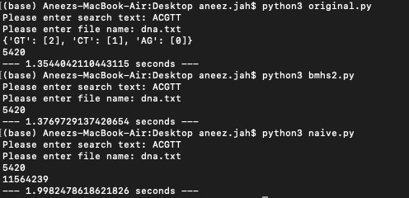

Slide 29
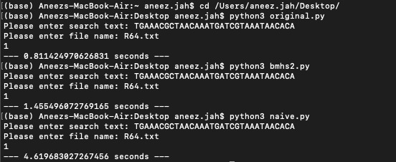

Slide 30
Q & A
Notes:
Moving on to the algorithms

Slide 31
Thank You!

